Slide 1
Intelligent Systems Machine Vision
Presented By: Emami, Jahani, Dehban, Mesforush

Slide 2
Table of Contents
What is Machine Vision?
Applications of Machine Vision
Image Reconstruction from feature maps
Object detection in videos

Slide 3
What is Machine Vision?

Slide 4
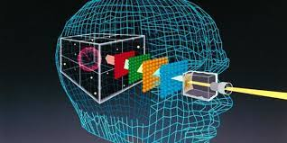
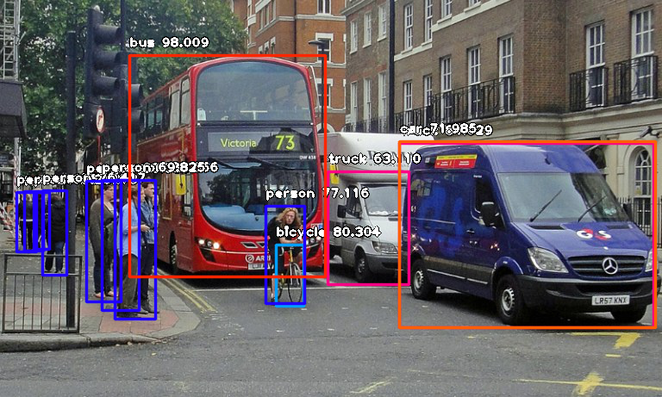
Machine vision is the technology and methods used to provide imaging-based automatic inspection and analysis.
It is good to note that the definition of machine vision varies in different sources, but all agree upon the fact that is used to extract and infer information from an image via different algorithms.

Slide 5
Applications of Machine Vision
Some of the most important applications of machine vision are:
Object Detection in photos and videos
Image classification via neural networks
Robot Guidance
Automatic inspection (such as cars)
Et cetera

Slide 6
Image reconstruction from feature maps

Slide 7
AlexNet
AlexNet is one of the most well known neural networks.
It consists of 5 convolutional and 3 fully connected layers.
The overall architecture can be seen below.

Slide 8
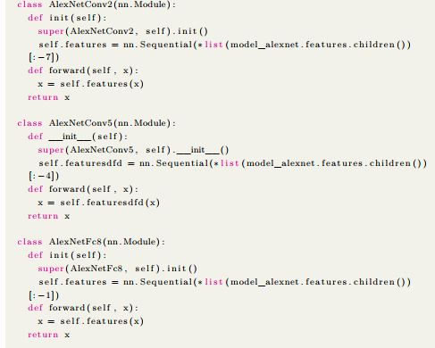
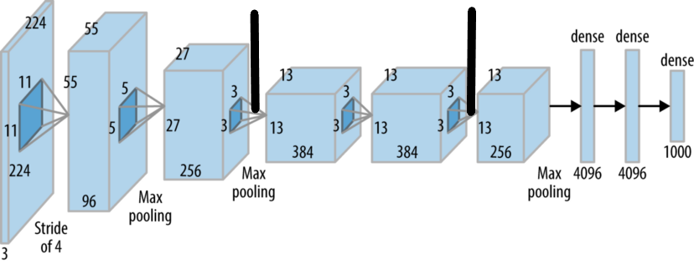
Extracting layer outputs
Here we attempt to extract the layer outputs of the AlexNet model to feed them into our designed neural network.

Slide 9
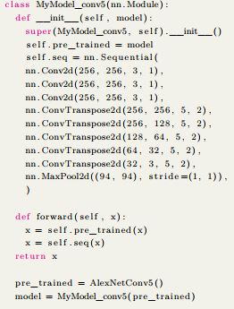
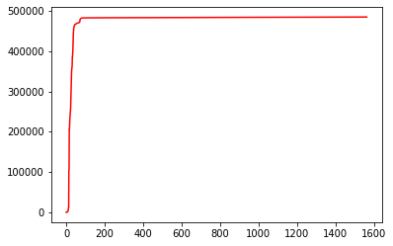
Feeding layer outputs to network
Here we design the following network to take the output.
The plot and code are as follows.

Slide 10
Extracted and discarded features
Conv layers are responsible to detect features to minimize error.
Shallower layers extract less complex features.
Deeper layers extract more abstract features.
Some layers discard undesirable and redundant features.

Slide 11
Object detection in videos

Slide 12
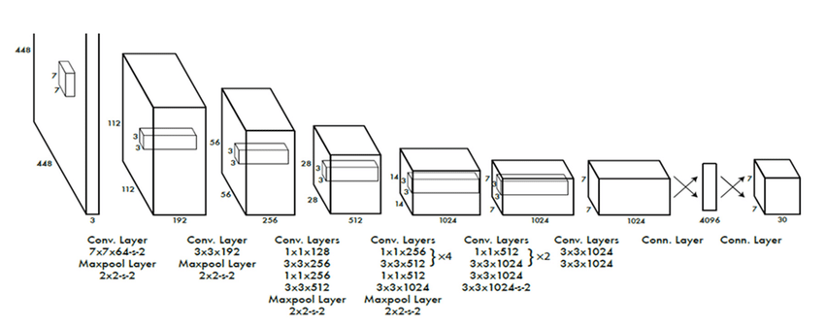
One of the most critical roles of machine vision as said before is object detection.
In this project we aim to perform object detection in a video using the YOLO model.
To do so we use the opencv library

Slide 13
Hog Face Detection Algorithm
The HOG algorithm is a popular feature descriptor widely used in image processing and computer vision.
Feature descriptors are the representation of an image that simply extracts the useful information and discarding unnecessary information.
It is also important to note that this is a robust algorithm and is used for many uses other than facial recognition.

Slide 14
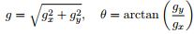
Hog algorithm steps
First of all we divide the photo into smaller cells.
We calculate the histogram for each cell, we use kernels then calculate the magnitude and direction as follows.
Merging the histograms to create a feature vector.

Slide 15
Pros of the HOG algorithm
Powerful descriptor
Accurate for object classification
Very useful for representing structural objects with low form variation

Slide 16
Cons of the HOG algorithm
Not a very fast descriptor
Accurate for object classification
May result in large feature vectors
If we have objects with structural variation the algorithm shall be faulty

Slide 17
Viola-Jones facial detection algorithm
This algorithm is of a cascaded object form, it uses Haar-like features and Adaboost learning to detect faces in photos.
It is important to note that the algorithm works with grayscale images.
This algorithm needs to check many different positions and scales.

Slide 18
Viola-Jones algorithm steps
Selecting Haar-like features
Creating an integral image
Running AdaBoost training
Creating classifier cascades

Slide 19
Haar-Like functions
Haar-like features are digital image features utilized in object recognition.
A simple way to find out which region is lighter or darker is to sum up the pixel values of both regions and compare them.
The sum of pixel values in the darker region will be smaller than the sum of pixels in the lighter region.

Slide 20
Different types of Haar like features
Edge features
Four-sided features
Line-features
Edge features and Line features are useful for detecting edges and lines.
The four-sided features are used for finding diagonal features.

Slide 21
Integral Images and Adaboost
We use integral images also known as summed-area tables to perform calculations quickly.
We us the AdaBoost algorithm which is a machine learning algorithm to extract the best features in facial recognition.
AdaBoost checks the performance of all classifiers with the features we support to it, then it chooses the best feature.

Slide 22
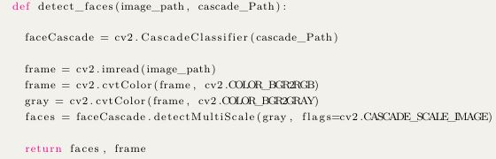
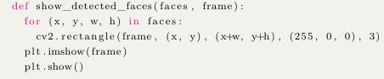
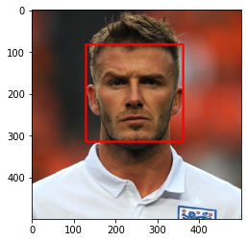
Implementation of Viola-Jones algorithm
Here we have implemented this algorithm via python.
The output is as follows:

Slide 23
Implementation of YOLO
The YOLOv3 model has been trained on the COCO dataset which has more than 30000 photos and 80 different classes.
In this project we have used the YOLOv3-320 model, this model has 320 pixels in width and height.

Slide 24
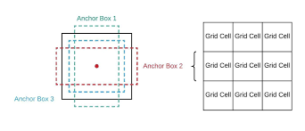
Grid cells
The idea behind YOLO is to output a number for the dimension which is large enough for all the objects to fit in it.
The original picture is cropped and divided into an n × n grid.
Each grid cell predicts two bounding boxes and one class.

Slide 25
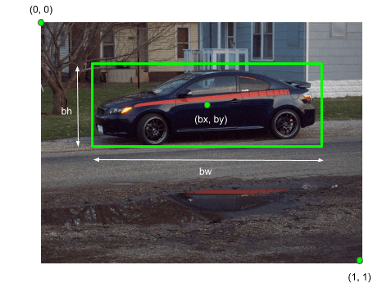
Bounding box
Bounding boxes are used in object detection and are rectangular shaped.
They are the border’s of the coordinates that enclose the object.

Slide 26
Parameters needed to define a bounding box
Class
Coordinates of edges
Coordinates of center
Height and Width
Confidence

Slide 27
Parameters of YOLO output
The tensor output of the YOLO model contains elements described as follows (Pc, x, y, h, w, c1, c2, c3, . . . , c80)
Pc:Probability of existence of an object within the cell
x:x-axis center of the bounding box
y:y-axis center of the bounding box
h:height of the bounding box
w:width of the bounding box
c_i:1 if class i is in the box, 0 if class i is not the box

Slide 28
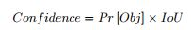
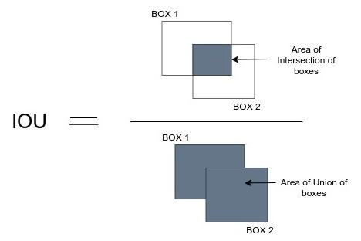
Confidence
This score shows the certainty that the box contains an object and how accurate the box performs its prediction.
The confidence of the YOLO model is calculated as below.
Where IoU is the intersection over union which is depicted as below.

Slide 29
YOLO loss function
The YOLO loss function consists of three sections:
Bounding box coordinates
Bounding box score prediction
Class score prediction
We know that YOLO predicts multiple bounding boxes per grid cell, all of which aren’t desirable.

Slide 30
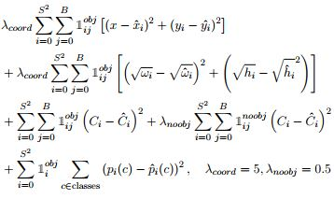
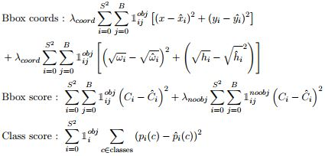
YOLO loss function
The YOLO loss function is depicted below.

Slide 31
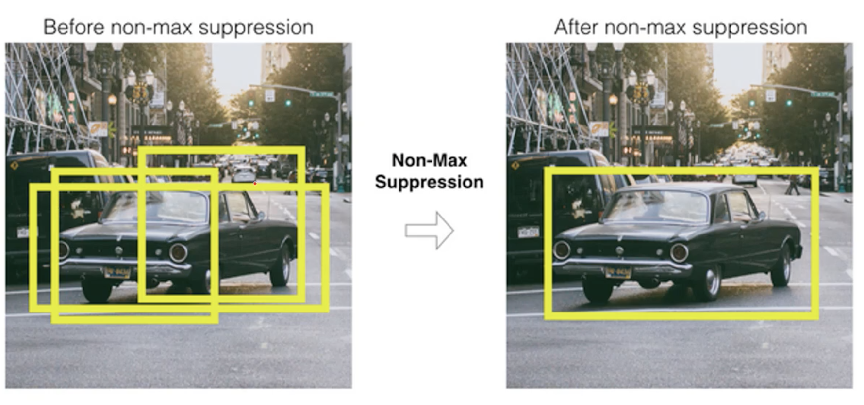
Non Max Suppression(NMS)
Non Max Suppression (NMS) is a series of algorithms to select a bounding box between overlapping boxes.
The parameters effective in this algorithm are:
IoU
Confidence

Slide 32
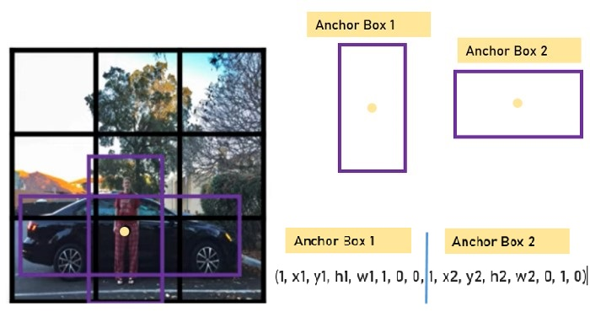
Multiple objects in grid cell
We must use multiple bounding boxes.
We predefine different shapes of bounding boxes. So we can have multiple predictions with multiple bounding boxes.

Slide 33
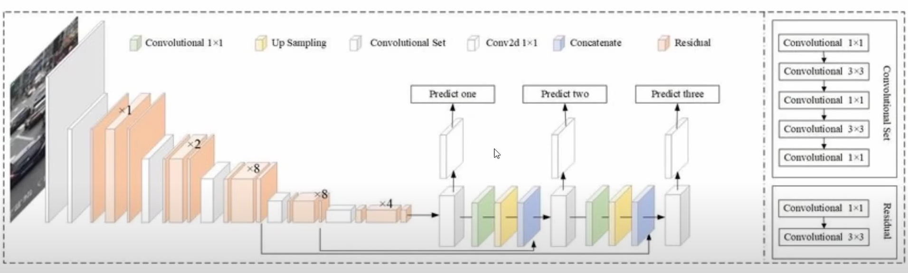
Implementation steps
First of all we take a look at the YOLO model, the output consists of three output layers.
The output tensor is as follows.
d = (Pc, x, , y, h, w, c1, c2, . . . , c80)

Slide 34
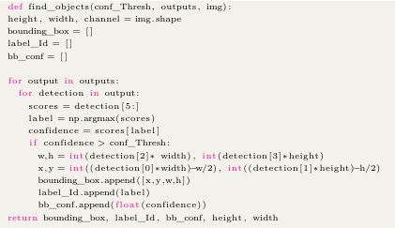
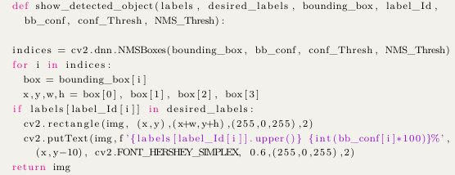
Implementation steps
We want to detect Cars, Busses and People in the video.
We define the following function to find the objects and another to show them and their labels on the video frames.

Slide 35
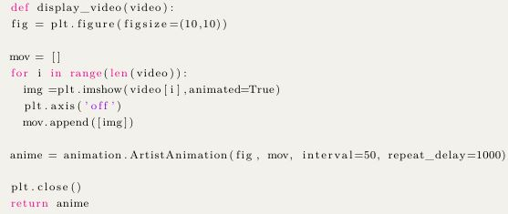
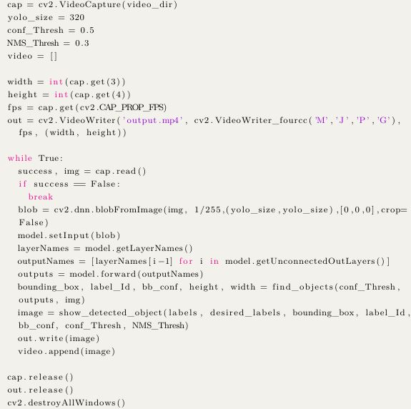
Implementation steps
In the final step we shall export the video with the following codes.

Slide 36
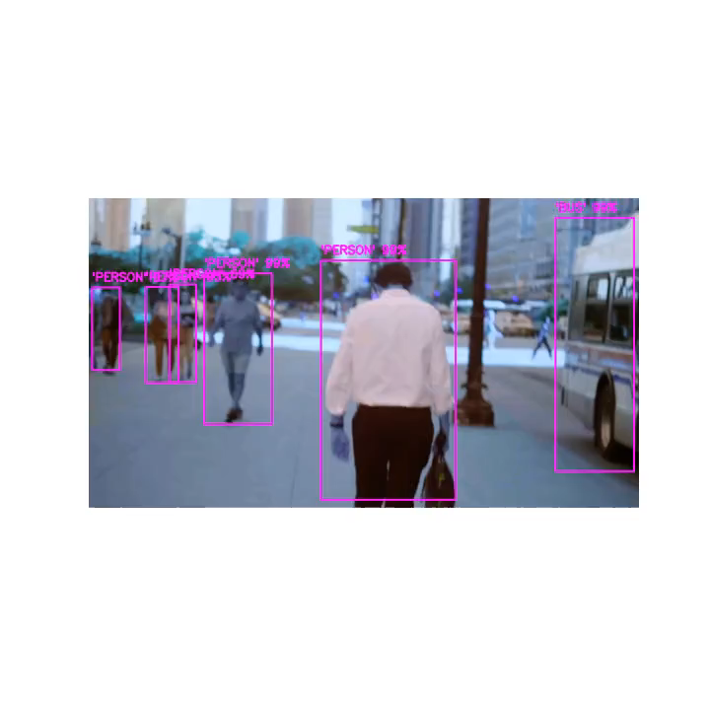
Output video
The output video is seen below.

Slide 37
Thank you

